Slide 1


Installing Fabric Composer
Install VS code & Plugin
Using VS Code: Open a Project
Using VS Code: Open a Terminal
Understand Development Scripts
Download & Setup Fabric Sample BYFN
Generate Crypto & launch network
View Artifacts
Download & Setup Hyperledger Explorer
Run the explorer

Slide 2
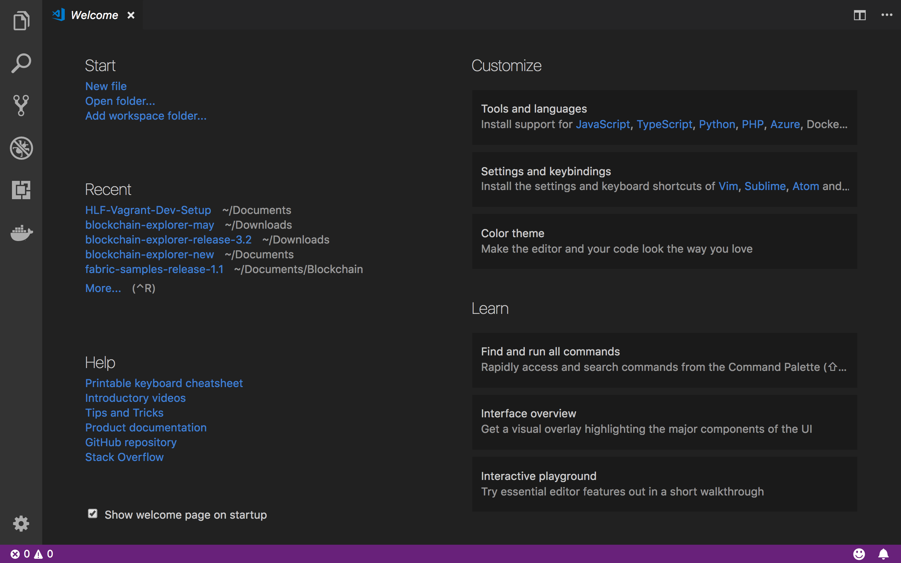
Browse Files
Open Folder
Install Extensions

Slide 3
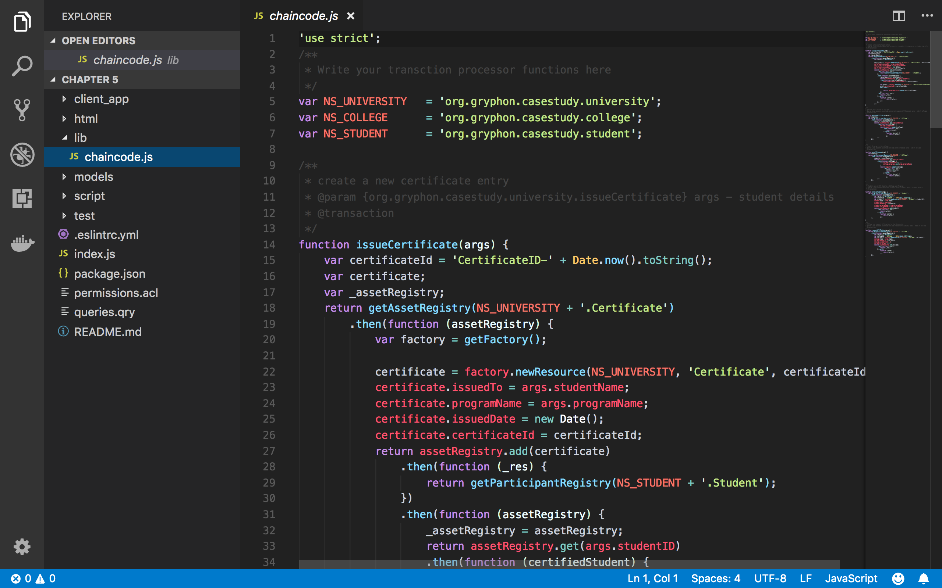

Slide 4
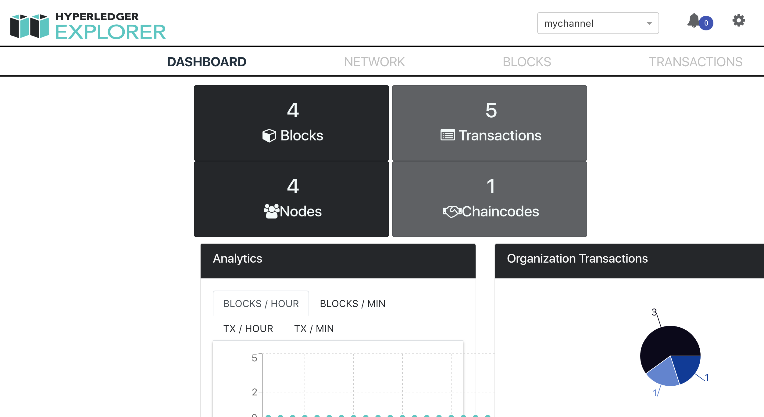
Will Display all comm channels

